Slide 1
NetworK SIMULATION CONCEPTS

Slide 2
WHAT IS NETWORK SIMULATION ?
WHY NETWORK SIMULATION ?
Provide practical feedback to users whiledesigning real world systems.
Allow designers of system to study
trouble and numerous abstraction levels.
Used in an affective way which means to teach otherwise demonstrate the concepts to students.
Provides accurate
understanding
USES OF NS
Predicts behavoius of
Computer network

Slide 3
NETWORK SIMULATORS
TYPES /
CLASSIFICATION
COMMERCIAL
OPEN SOURCE
NS2
QUALNET
J-sim
OPNET
NS3
OMNET++
SSFNET

Slide 4
NS2
Event Driven
Network Simulator
In built C++ and
Otcl script
Follows Object Oriented
Approach
NS2

Slide 5
NS2 AND NS3 COMPARISON
CRITERIA | NS2 | NS3
Released at | 1996 | 2008
Supported by | DARPA,VINT,SAMAN,NSF & CONSER | NSF & INRIA
Based on | NS -1 & REAL Simulator | NS-2 ,GTS-Nets, YANS
Built in | C++ | C++
Scripting | OTcl | Python
Simulation Output | NAM | NS-3-viz, pyviz, nam

Slide 6
TCL SCRIPT BASICS
VARIABLE DECLARATION : - set [variable name] [value of variable]
ACCESSING A VARIABLE :- $[variable name]
FUNCTIONS ARE CALLED PROCEDURES
COMMENT : #
If { expression }
{ some commands } else { some commands }
EXPLORE MORE IN DEPTH FROM THE BOOK NS2 FOR BEGINERS AVAILABLE AT
http://www.krishnagudi.com/wp-content/uploads/2020/09/ns-for-beginners.pdf

Slide 7
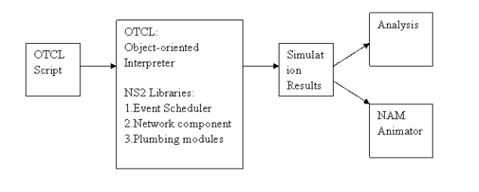
SIMPLIFIED USER'S VIEW OF NS2

Slide 8
Two nodes Point to Point network, duplex link : Without Traffic

Slide 9
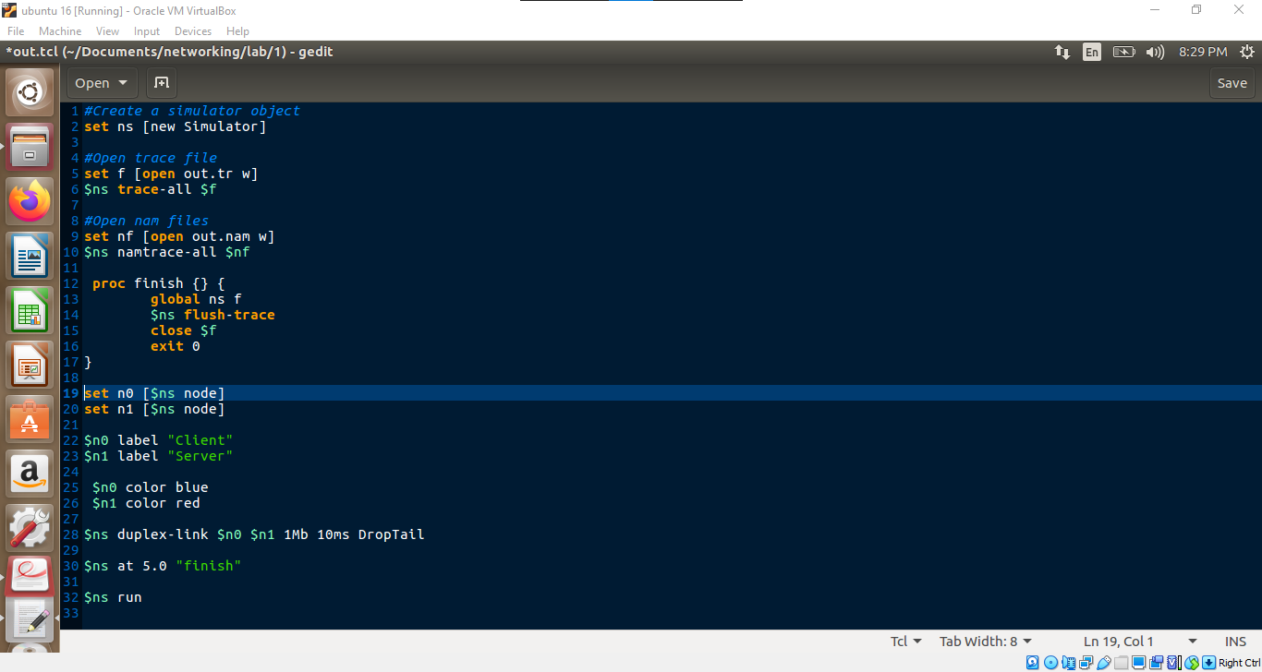
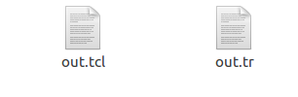

PROC -> FUNTION OR METHODS
FINISH -> FINISH IS A FUNCTION NAME

Slide 10
n0
1mb 10ms
n1
Client
Server

Slide 11
Two nodes Point to Point network, duplex link : With Traffic

Slide 12
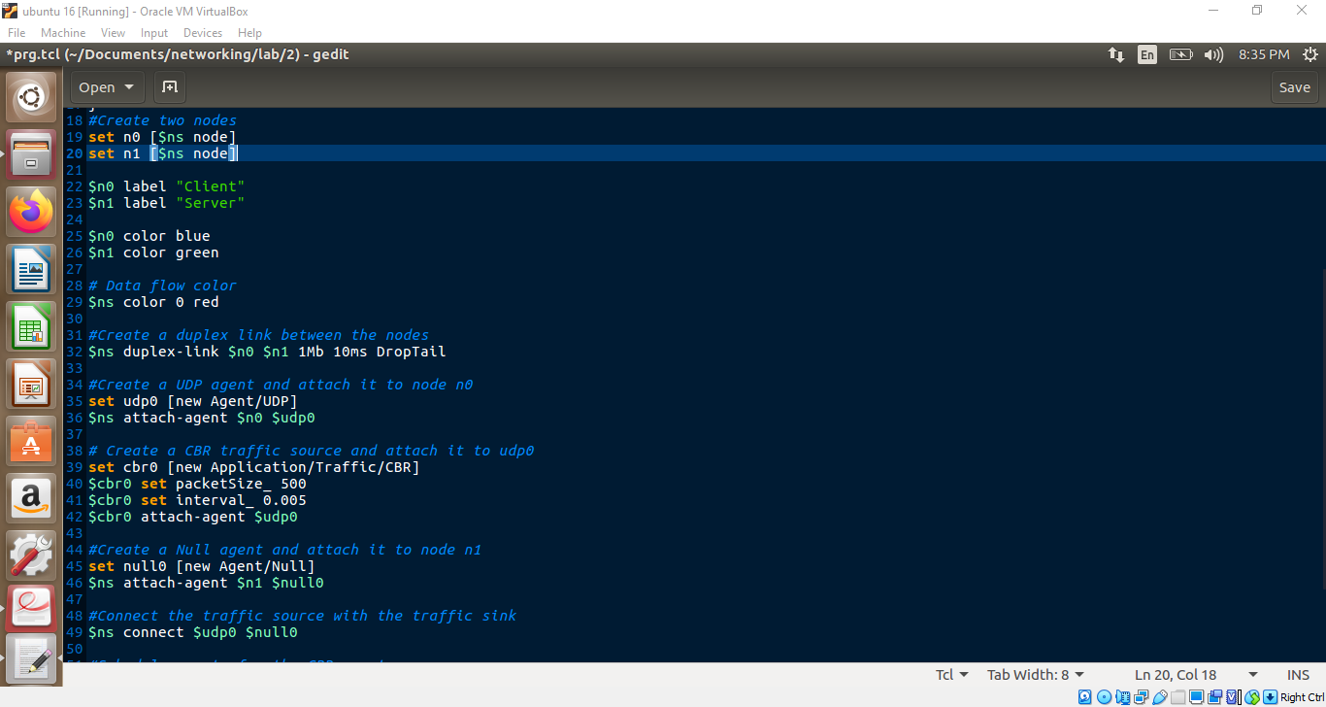
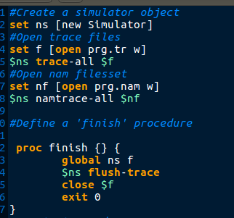

Slide 13
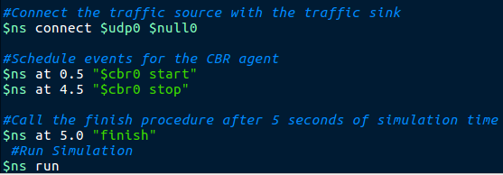
UDP -> USER DATAGRAM PROTOCOL
CBR -> CONSTANT BIT RATE
cbr0
udp0
null0
n0
1mb 10ms
n1
cbr0
udp0
null0
n0
n1
1mb 10ms

Slide 14
analyzing the output through NAM Tool and trace file

Slide 15
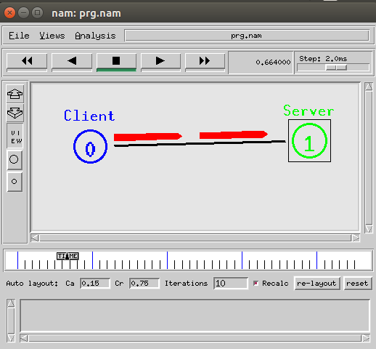
NAM VISUALIZATION TOOL
PLAY , PAUSE , FORWARD ,REWIND
PLAYBACK SPEED
ZOOM IN
ZOOM OUT
TOGGLE
VIEW/EDIT
TIMELINE

Slide 16
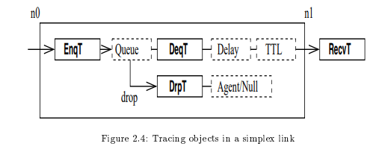
QUEING MECHANISM
ENQ - REGISTERS THE INFORMATION OF RECEIVING PACKET AND ADDS TO QUEUE
DEQ - REGISTERS THE INFORMATION OF PACKET WHEN REMOVED FROM THE QUEUE
RECV – GIVES INFORMATION ABOUT THE PACKET RECEIVED

Slide 17
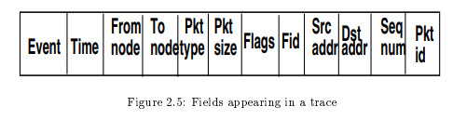
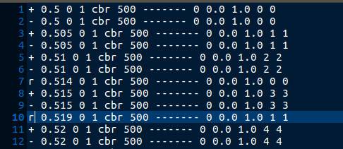
EXPLORING TRACE FILE
CBR PACKET
TIME INTERVAL 0.05 SECONDS

Slide 18

PRESENTATION BY -
PUJARI VISHNUPRIYA(1KS18CS073)
PULLUR PAVAN KUMAR(1KS18CS074)
SHIVANGI SRIVASTAVA(1KS18CS093)
SOURABH SANTOSH KAMBLE (1KS18CS097)

